Slide 2

Accelerating Generative AI application development with Llama Stack
Ravikanth Chaganti
Distinguished Engineer, Dell Technologies
Azure Cloud Native MVP & Author

Slide 3
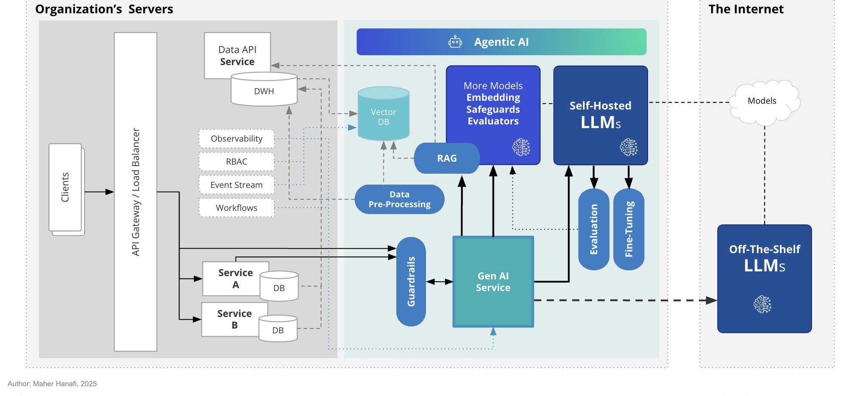
GenAI application architecture
Notes:
If you have built distributed applications or systems, you will understand that the principles such as abstraction and decoupling are essential to manage dependencies on external services or microservices. Developing AI applications that are enterprise-grade is no different. If you're building features powered by a single LLM or orchestrating complex AI agents, a critical design principle is key: Abstract your AI implementation! ⚠️ The problem: Coupling your core application logic directly to a specific AI model endpoint, a particular agent framework or a sequence of AI calls can create significant difficulties down the line, similar to the challenges of tightly coupled distributed systems: ✴️ Complexity: Your application logic gets coupled with the specifics of how the AI task is performed. ✴️ Performance: Swapping for a faster model or optimizing an agentic workflow becomes difficult. ✴️ Governance: Adapting to new data handling rules or model requirements involves widespread code changes across tightly coupled components. ✴️ Innovation: Integrating newer, better models or more sophisticated agentic techniques requires costly refactoring, limiting your ability to leverage advancements. 💠 The Solution? Design an AI Abstraction Layer. Build an interface (or a proxy) between your core application and the specific AI capability it needs. This layer exposes abstract functions and handles the underlying implementation details – whether that's calling a specific LLM API, running a multi-step agent, or interacting with a fine-tuned model. This "abstract the AI" approach provides crucial flexibility, much like abstracting external services in a distributed system: ✳️ Swap underlying models or agent architectures easily without impacting core logic. ✳️ Integrate performance optimizations within the AI layer. ✳️ Adapt quickly to evolving policy and compliance needs. ✳️ Accelerate innovation by plugging in new AI advancements seamlessly behind the stable interface. Designing for abstraction ensures your AI applications are not just functional today, but also resilient, adaptable and easier to evolve in the face of rapidly changing AI technology and requirements.

Slide 4
Challenges building enterprise AI applications
Higher infrastructure complexity
Requires non-trivial capabilities
Lack of flexibility and choice
Notes:
Infrastructure Complexity
Running large language models efficiently requires specialized infrastructure.
Different deployment scenarios (local development, cloud, edge) need different solutions.
Moving from development to production often requires significant rework.
Essential Capabilities
Safety guardrails and content filtering are necessary in an enterprise setting.
Just model inference is not enough - Knowledge retrieval and RAG capabilities are required.
Nearly any application needs composable multi-step workflows.
Finally, without monitoring, observability and evaluation, you end up operating in the dark.
Lack of Flexibility and Choice
Directly integrating with multiple providers creates tight coupling.
Different providers have different APIs and abstractions.
Changing providers requires significant code changes.

Slide 5
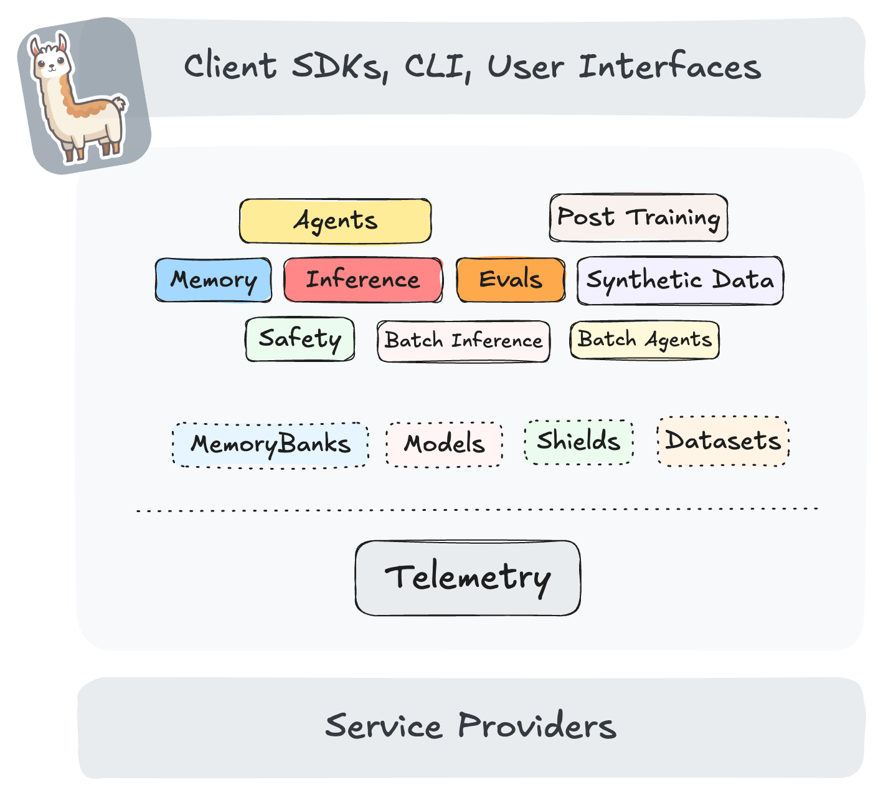
Introducing Llama Stack
An open-source framework for building generative AI applications using standard building blocks
Offers standard APIs for
Agentic applications
Model Life Cycle

Slide 6
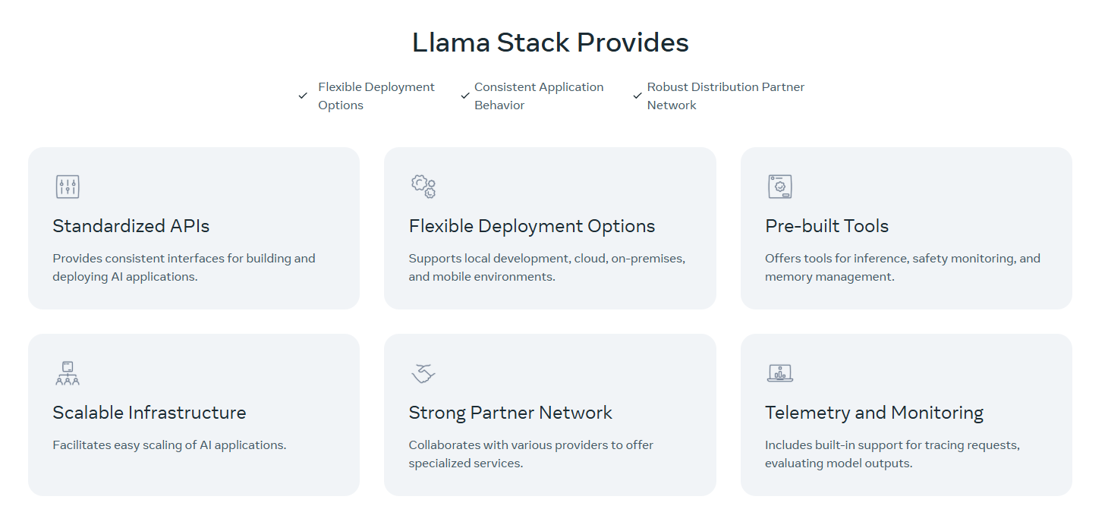
Llama Stack Features
Notes:
Llama Stack addresses these challenges through a service-oriented, API-first approach:
Develop Anywhere, Deploy Everywhere
Start locally with CPU-only setups
Move to GPU acceleration when needed
Deploy to cloud or edge without code changes
Same APIs and developer experience everywhere
Production-Ready Building Blocks
Pre-built safety guardrails and content filtering
Built-in RAG and agent capabilities
Comprehensive evaluation toolkit
Full observability and monitoring
True Provider Independence
Swap providers without application changes
Mix and match best-in-class implementations
Federation and fallback support
No vendor lock-in
Robust Ecosystem
Llama Stack is already integrated with distribution partners (cloud providers, hardware vendors, and AI-focused companies).
Ecosystem offers tailored infrastructure, software, and services for deploying a variety of models.
Our Philosophy
Service-Oriented: REST APIs enforce clean interfaces and enable seamless transitions across different environments.
Composability: Every component is independent but works together seamlessly
Production Ready: Built for real-world applications, not just demos
Turnkey Solutions: Easy to deploy built in solutions for popular deployment scenarios
With Llama Stack, you can focus on building your application while we handle the infrastructure complexity, essential capabilities, and provider integrations.

Slide 7
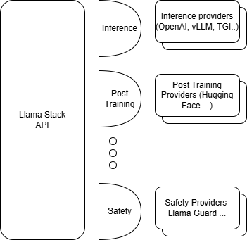
Llama Stack Adapters
Adapters enable access to a provider
Enable swapping out different implementations for the same API.
LLM inference providers (e.g., Fireworks, Together, AWS Bedrock, Groq, Cerebras, SambaNova, vLLM, etc.),
Vector databases (e.g., ChromaDB, Weaviate, Qdrant, Milvus, FAISS, PGVector, etc.),
Safety providers (e.g., Meta’s Llama Guard, AWS Bedrock Guardrails, etc.)
Come in two flavors
Remote
Inline (at least one)

Slide 8
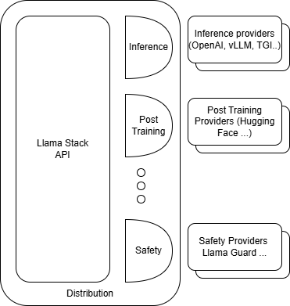
Llama Stack Distributions
A specific set of pre-packaged versions of the Llama Stack API and providers.
Called a Llama Stack Distribution
Three distro types
Remotely hosted
Locally hosted
On-device

Slide 9
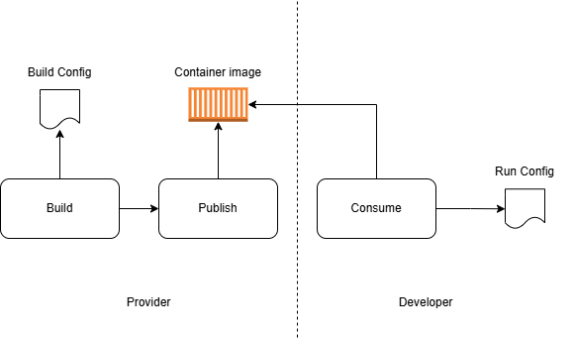
Llama Stack Workflow

Slide 10
Demo

